Slide 1


MUBI Platform Database Project
Batalan Vlad
Database Engineer Intern
Notes:
Chapter Intro Slide (version C)
This slide should be used at the beginning of each “chapter” of your presentation (as introduced in the Agenda slide) to keep the audience aware of their place in the story and to help break things up. Change the text and chapter number accordingly. If you do not need a sub-head (the smaller text), delete it. Use different backgrounds for different chapter titles, try not to repeat a background.
Very short presentations (< ~10 slides) may not need Chapter Intro Slides.
There are multiple versions of this template with various white and black background images starting on slide 10.

Slide 2

Agenda
Alegerea unui dataset potrivit pentru generare de rapoarte
Alegerea engine-ului potrivit pentru manipularea datelor
Realizarea structurii normalizate a tabelelor
Alegerea unui tool potrivit de ETL
Preprocesare pentru etl
Job-uri Talend
Alegerea unui tool de BI potrivit
Premergator realizarii rapoartelor
Rapoarte realizate in tableau
Notes:
Agenda
General Template Guidance: Information to help you make good presentations.
Standard / Static Slides: Some key Endava slides/lockups that, in general, should only be modified by marketing.
Template Slides: A selection of template slides for use in Endava presentations.
Larger Format Template Slides: Template slides with larger content.
Icon Library: A selection of hundreds of icons to use in Endava presentations.

Slide 3

1
MUBI Platform
Alegerea unui dataset potrivit pentru generare de rapoarte
Notes:
Chapter Intro Slide (version P)
This slide should be used at the beginning of each “chapter” of your presentation (as introduced in the Agenda slide) to keep the audience aware of their place in the story and to help break things up. Change the text and chapter number accordingly. If you do not need a sub-head (the smaller text), delete it. Use different backgrounds for different chapter titles, try not to repeat a background.
Very short presentations (< ~10 slides) may not need Chapter Intro Slides.
There are multiple versions of this template with various white and black background images starting on slide 10.

Slide 4

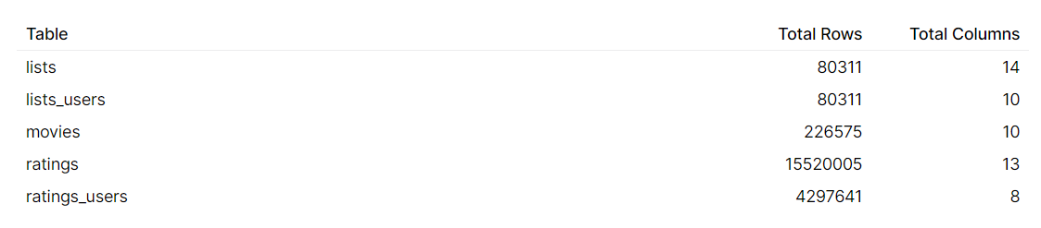
1
Alegerea unui dataset potrivit pentru generare de rapoarte
MUBI - "Netflix for art lovers"
Datele au fost preluate de pe Kaggle:
https://www.kaggle.com/clementmsika/mubi-sqlite-database-for-movie-lovers
Acestea au fost colectate de către utilizatorul Clément Msika prin intermediul API-ului furnizat de către MUBI.
Notes:
Standard text slide (version 5)
Creating visual differences in text-heavy pages keeps the audience interested and engaged.
Using bold and highlighted coloured text draws the reader into the important part of the text. Use this sparing throughout the text, if it is used too much, the page becomes busy, it loses its’ meaning.
Varying the length of the paragraphs as well as using bulleted and numeric lists help with keeping the reader engaged. Lists help to “skim” the information on the page and allow the audience to absorb a just the key information.

Slide 5
1
Alegerea unui dataset potrivit pentru generare de rapoarte
Probleme aduse de acest dataset
Datele din tabel nu sunt normalizate
Tabela “movies” conține câmpurile “director_id”, “director_name” si “director_url” cu elemente separate prin virgulă.
Tabelele “lists_users” si “ratings” conțin date despre useri care trebuie colectate într-un singur tabel “users”.
Deoarece coloanele nu conțin date atomice (are elemente separate prin virgulă), fișierul CSV trebuie reformatat pentru a fi citibil
Am optat pentru varianta în SQLite.
Numărul de înregistrări din tabela "ratings" este mare
Conține circa 15.000.000 de înregistrări.
Notes:
Standard text slide (version 5)
Creating visual differences in text-heavy pages keeps the audience interested and engaged.
Using bold and highlighted coloured text draws the reader into the important part of the text. Use this sparing throughout the text, if it is used too much, the page becomes busy, it loses its’ meaning.
Varying the length of the paragraphs as well as using bulleted and numeric lists help with keeping the reader engaged. Lists help to “skim” the information on the page and allow the audience to absorb a just the key information.

Slide 6
2
MUBI Platform
Alegerea engine-ului potrivit pentru manipularea datelor
Notes:
Chapter Intro Slide (version N)
This slide should be used at the beginning of each “chapter” of your presentation (as introduced in the Agenda slide) to keep the audience aware of their place in the story and to help break things up. Change the text and chapter number accordingly. If you do not need a sub-head (the smaller text), delete it. Use different backgrounds for different chapter titles, try not to repeat a background.
Very short presentations (< ~10 slides) may not need Chapter Intro Slides.
There are multiple versions of this template with various white and black background images starting on slide 10.

Slide 7

2
Alegerea engine-ului potrivit pentru manipularea datelor
PostgreSQL over SQLite
Are nevoie de un server pe care să ruleze.
Deține o multitudine de tipuri de date diferite.
Este mai puțin portabil, necesitând export la codul SQL.
Suportă multiacces din partea mai multor useri.
Scripturi server-side: PL/PGSQL
Embedded, Serverless.
Suportă doar 5 tipuri de date: (NULL, Integer, Real, Text, Blob).
Este o baza de date portabilă (motivul pentru care am putut importa cu ușurință dataset-ul de pe Kaggle).
Nu suportă multiacces din partea mai multor useri.
Nu oferă suport pentru scripturi server-side
.
Notes:
Standard text slide (version 5)
Creating visual differences in text-heavy pages keeps the audience interested and engaged.
Using bold and highlighted coloured text draws the reader into the important part of the text. Use this sparing throughout the text, if it is used too much, the page becomes busy, it loses its’ meaning.
Varying the length of the paragraphs as well as using bulleted and numeric lists help with keeping the reader engaged. Lists help to “skim” the information on the page and allow the audience to absorb a just the key information.

Slide 8


2
Alegerea engine-ului potrivit pentru manipularea datelor
PostgreSQL
În urma analizei, am ales PostgreSQL ca engine principal pentru dataset-ul meu.
La alegere a contribuit si faptul că în Talend (tool-ul de ETL ales) nu sunt recunoscute automat schemele de SQLite.
Am utilizat Tool-ul DBeaver pentru a migra rapid datele brute din baza de date SQLite luată de pe Kaggle într-o bază de date PostgreSQL.
Notes:
Standard text slide (version 5)
Creating visual differences in text-heavy pages keeps the audience interested and engaged.
Using bold and highlighted coloured text draws the reader into the important part of the text. Use this sparing throughout the text, if it is used too much, the page becomes busy, it loses its’ meaning.
Varying the length of the paragraphs as well as using bulleted and numeric lists help with keeping the reader engaged. Lists help to “skim” the information on the page and allow the audience to absorb a just the key information.

Slide 9
3
MUBI Platform
Realizarea structurii normalizate a tabelelor
Notes:
Chapter Intro Slide (version N)
This slide should be used at the beginning of each “chapter” of your presentation (as introduced in the Agenda slide) to keep the audience aware of their place in the story and to help break things up. Change the text and chapter number accordingly. If you do not need a sub-head (the smaller text), delete it. Use different backgrounds for different chapter titles, try not to repeat a background.
Very short presentations (< ~10 slides) may not need Chapter Intro Slides.
There are multiple versions of this template with various white and black background images starting on slide 10.

Slide 10
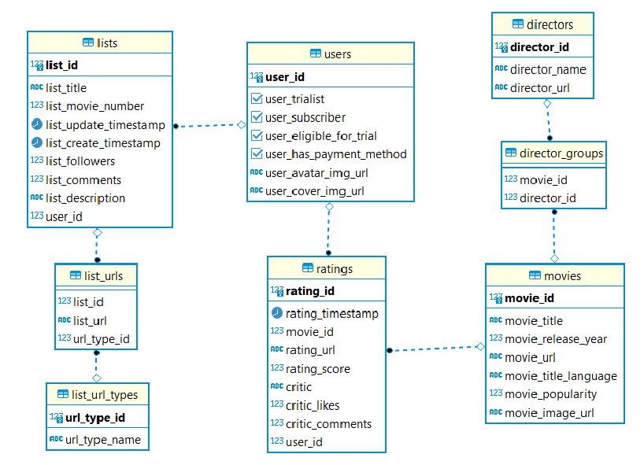
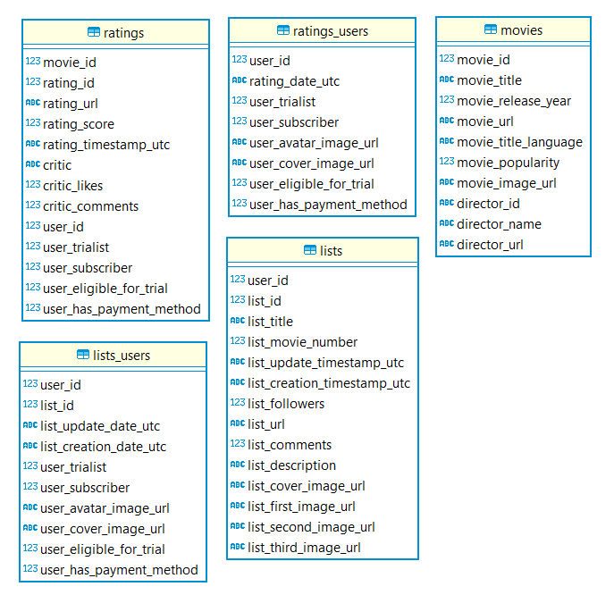
3
Realizarea structurii normalizate a tabelelor
Dataset raw
Dataset normalizat
Notes:
Standard text slide (version 5)
Creating visual differences in text-heavy pages keeps the audience interested and engaged.
Using bold and highlighted coloured text draws the reader into the important part of the text. Use this sparing throughout the text, if it is used too much, the page becomes busy, it loses its’ meaning.
Varying the length of the paragraphs as well as using bulleted and numeric lists help with keeping the reader engaged. Lists help to “skim” the information on the page and allow the audience to absorb a just the key information.

Slide 11
4
MUBI Platform
Alegerea unui tool potrivit de ETL
Notes:
Chapter Intro Slide (version N)
This slide should be used at the beginning of each “chapter” of your presentation (as introduced in the Agenda slide) to keep the audience aware of their place in the story and to help break things up. Change the text and chapter number accordingly. If you do not need a sub-head (the smaller text), delete it. Use different backgrounds for different chapter titles, try not to repeat a background.
Very short presentations (< ~10 slides) may not need Chapter Intro Slides.
There are multiple versions of this template with various white and black background images starting on slide 10.

Slide 12

4
Alegerea unui tool potrivit de ETL
Talend – tool-ul potrivit
Restricții impuse:
Tabela "ratings" conține un volum mare de date ale căror procesări sunt costisitoare de timp.
Performanța cu care execută query-urile (de exemplu: join între tabele) este o caracteristică care trebuie luată în considerare.
Tool-ul ales trebuie să suporte import-ul din mai multe tipuri de surse.
În cazul nostru: baza de date PostgreSQL și fișiere CSV.
Notes:
Standard text slide (version 5)
Creating visual differences in text-heavy pages keeps the audience interested and engaged.
Using bold and highlighted coloured text draws the reader into the important part of the text. Use this sparing throughout the text, if it is used too much, the page becomes busy, it loses its’ meaning.
Varying the length of the paragraphs as well as using bulleted and numeric lists help with keeping the reader engaged. Lists help to “skim” the information on the page and allow the audience to absorb a just the key information.

Slide 13
5
MUBI Platform
Preprocesare pentru ETL
Notes:
Chapter Intro Slide (version N)
This slide should be used at the beginning of each “chapter” of your presentation (as introduced in the Agenda slide) to keep the audience aware of their place in the story and to help break things up. Change the text and chapter number accordingly. If you do not need a sub-head (the smaller text), delete it. Use different backgrounds for different chapter titles, try not to repeat a background.
Very short presentations (< ~10 slides) may not need Chapter Intro Slides.
There are multiple versions of this template with various white and black background images starting on slide 10.

Slide 14
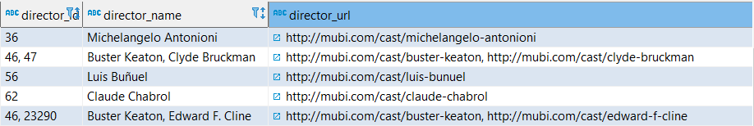
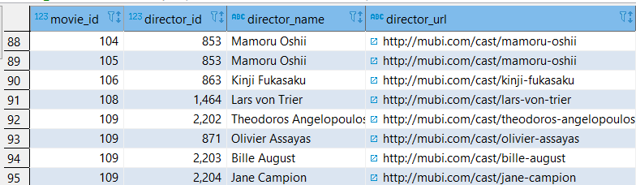
5
Preprocesare pentru ETL
Normalizare la forma normală 1 pentru directorii din tabela "movies"
Am ales să folosesc PL/PGSQL pentru a genera un materialized view care conține informațiile structurate pentru a fi ușor transformate în Talend.
Informația neprelucrată din tabela "movies":
Conținutul view-ului rezultat:
Notes:
Standard text slide (version 5)
Creating visual differences in text-heavy pages keeps the audience interested and engaged.
Using bold and highlighted coloured text draws the reader into the important part of the text. Use this sparing throughout the text, if it is used too much, the page becomes busy, it loses its’ meaning.
Varying the length of the paragraphs as well as using bulleted and numeric lists help with keeping the reader engaged. Lists help to “skim” the information on the page and allow the audience to absorb a just the key information.

Slide 15
6
MUBI Platform
Job-uri Talend
Notes:
Chapter Intro Slide (version N)
This slide should be used at the beginning of each “chapter” of your presentation (as introduced in the Agenda slide) to keep the audience aware of their place in the story and to help break things up. Change the text and chapter number accordingly. If you do not need a sub-head (the smaller text), delete it. Use different backgrounds for different chapter titles, try not to repeat a background.
Very short presentations (< ~10 slides) may not need Chapter Intro Slides.
There are multiple versions of this template with various white and black background images starting on slide 10.

Slide 16
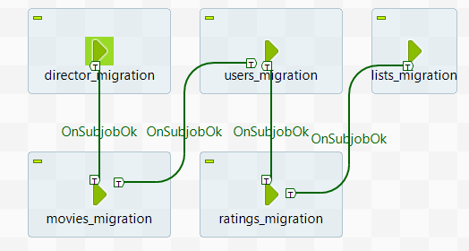
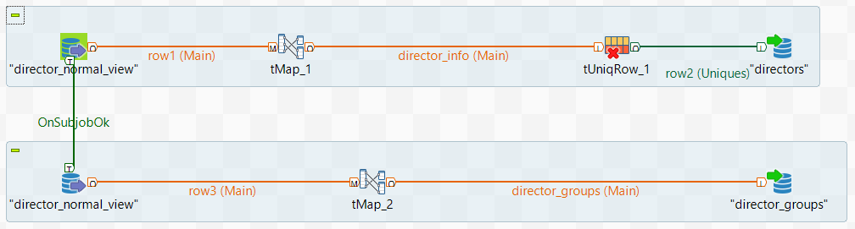
6
Job-uri Talend
Este importantă ordinea în care sunt transformate informațiile, deoarece acestea sunt influențate de constrângerile referențiale.
De exemplu, dacă se trimit date in tabela “director_groups”, exista șansa sa existe un director_id care nu are corespondent in tabela “directors” sau un movie_id care să nu existe în tabela "movies". Acest lucru prioritizează popularea tabelelor “directors” și "movies".
În job-ul "director_migration", sunt populate tabelele "directors" și "director_groups", utilizând view-ul "director_normal_view" creat în etapa anterioară.
mubi_job_orchestrator
Director_migration
Notes:
Standard text slide (version 5)
Creating visual differences in text-heavy pages keeps the audience interested and engaged.
Using bold and highlighted coloured text draws the reader into the important part of the text. Use this sparing throughout the text, if it is used too much, the page becomes busy, it loses its’ meaning.
Varying the length of the paragraphs as well as using bulleted and numeric lists help with keeping the reader engaged. Lists help to “skim” the information on the page and allow the audience to absorb a just the key information.

Slide 17
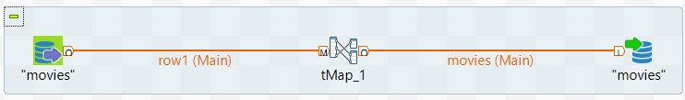
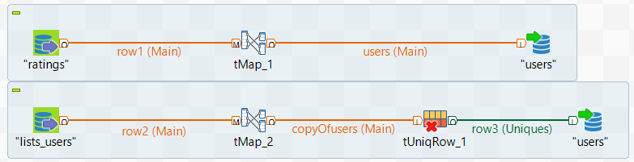
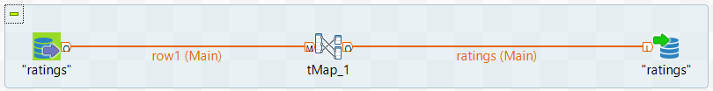
6
Job-uri Talend
Pentru următoarele job-uri, se utilizează o mapare simplă, maxim o componentă care asigura unicitatea rândului.
Movie_migration
mubi_job_orchestrator
Users_migration
Ratings_migration
Notes:
Standard text slide (version 5)
Creating visual differences in text-heavy pages keeps the audience interested and engaged.
Using bold and highlighted coloured text draws the reader into the important part of the text. Use this sparing throughout the text, if it is used too much, the page becomes busy, it loses its’ meaning.
Varying the length of the paragraphs as well as using bulleted and numeric lists help with keeping the reader engaged. Lists help to “skim” the information on the page and allow the audience to absorb a just the key information.

Slide 18
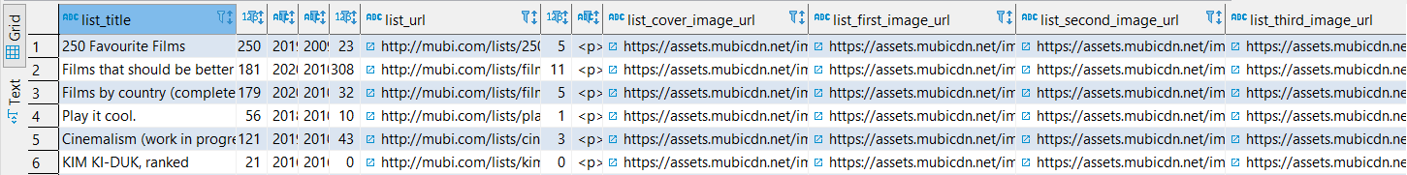
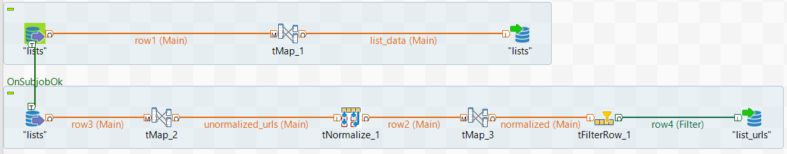
6
Job-uri Talend
Realizarea transformării asupra tabelei "lists" a fost una problematică.
Problema principală fiind nevoia de a transforma coloanele care conțin url-uri în rânduri.
Soluția în Talend:
Se transpun toate coloanele în una singură sub formatul: <url>;1,<cover>;2,<first>;3,<second>;4,<third>;5
Procesul este realizat În componenta tMap_2
Se realizeaza normalizare dupa delimitatorul ",".
tMap_3 va împărți fiecare url de format <url>;<tip_url> în două componente diferite.
Rezultatul va fi inserat în tabelele normalizate.
mubi_job_orchestrator
Lists_migration
Notes:
Standard text slide (version 5)
Creating visual differences in text-heavy pages keeps the audience interested and engaged.
Using bold and highlighted coloured text draws the reader into the important part of the text. Use this sparing throughout the text, if it is used too much, the page becomes busy, it loses its’ meaning.
Varying the length of the paragraphs as well as using bulleted and numeric lists help with keeping the reader engaged. Lists help to “skim” the information on the page and allow the audience to absorb a just the key information.

Slide 19
7
MUBI Platform
Alegerea unui tool de BI potrivit
Notes:
Chapter Intro Slide (version N)
This slide should be used at the beginning of each “chapter” of your presentation (as introduced in the Agenda slide) to keep the audience aware of their place in the story and to help break things up. Change the text and chapter number accordingly. If you do not need a sub-head (the smaller text), delete it. Use different backgrounds for different chapter titles, try not to repeat a background.
Very short presentations (< ~10 slides) may not need Chapter Intro Slides.
There are multiple versions of this template with various white and black background images starting on slide 10.

Slide 20

7
Alegerea unui tool de BI potrivit
Tableau
Spre deosebire de alte tool-uri de BI (PowerBi), Tableau oferă posibilitatea de a crea tabele din comenzi SQL, conferind în același timp o performanță sporită la realizarea diferitelor task-uri.
Tableau este un tool interactiv, având la dispoziție un UI friendly. De asemenea, poate prelua date dintr-o gamă foarte mare de surse (diferite engine-uri pt baze de date, Cloud, fișiere locale in formaturi multiple).
Notes:
Standard text slide (version 5)
Creating visual differences in text-heavy pages keeps the audience interested and engaged.
Using bold and highlighted coloured text draws the reader into the important part of the text. Use this sparing throughout the text, if it is used too much, the page becomes busy, it loses its’ meaning.
Varying the length of the paragraphs as well as using bulleted and numeric lists help with keeping the reader engaged. Lists help to “skim” the information on the page and allow the audience to absorb a just the key information.

Slide 21
8
MUBI Platform
Premergător realizării rapoartelor
Notes:
Chapter Intro Slide (version N)
This slide should be used at the beginning of each “chapter” of your presentation (as introduced in the Agenda slide) to keep the audience aware of their place in the story and to help break things up. Change the text and chapter number accordingly. If you do not need a sub-head (the smaller text), delete it. Use different backgrounds for different chapter titles, try not to repeat a background.
Very short presentations (< ~10 slides) may not need Chapter Intro Slides.
There are multiple versions of this template with various white and black background images starting on slide 10.

Slide 22
8
Premergător realizării rapoartelor
Un nou dataset adăugat
Datele normalizate preluate din PostgreSQL au fost completate cu un dataset ce poate fi găsit pe următorul link:
https://zenodo.org/record/1240586#.YSS1Xo4zZPZ
Acesta conține completări la filme legate de budget si revenue. Legătura dintre aceste date și tabela "movies" a fost făcută prin intermediul titlului filmului.
Notes:
Standard text slide (version 5)
Creating visual differences in text-heavy pages keeps the audience interested and engaged.
Using bold and highlighted coloured text draws the reader into the important part of the text. Use this sparing throughout the text, if it is used too much, the page becomes busy, it loses its’ meaning.
Varying the length of the paragraphs as well as using bulleted and numeric lists help with keeping the reader engaged. Lists help to “skim” the information on the page and allow the audience to absorb a just the key information.

Slide 23
9
MUBI Platform
Rapoarte realizate in Tableau
Notes:
Chapter Intro Slide (version N)
This slide should be used at the beginning of each “chapter” of your presentation (as introduced in the Agenda slide) to keep the audience aware of their place in the story and to help break things up. Change the text and chapter number accordingly. If you do not need a sub-head (the smaller text), delete it. Use different backgrounds for different chapter titles, try not to repeat a background.
Very short presentations (< ~10 slides) may not need Chapter Intro Slides.
There are multiple versions of this template with various white and black background images starting on slide 10.

Slide 24
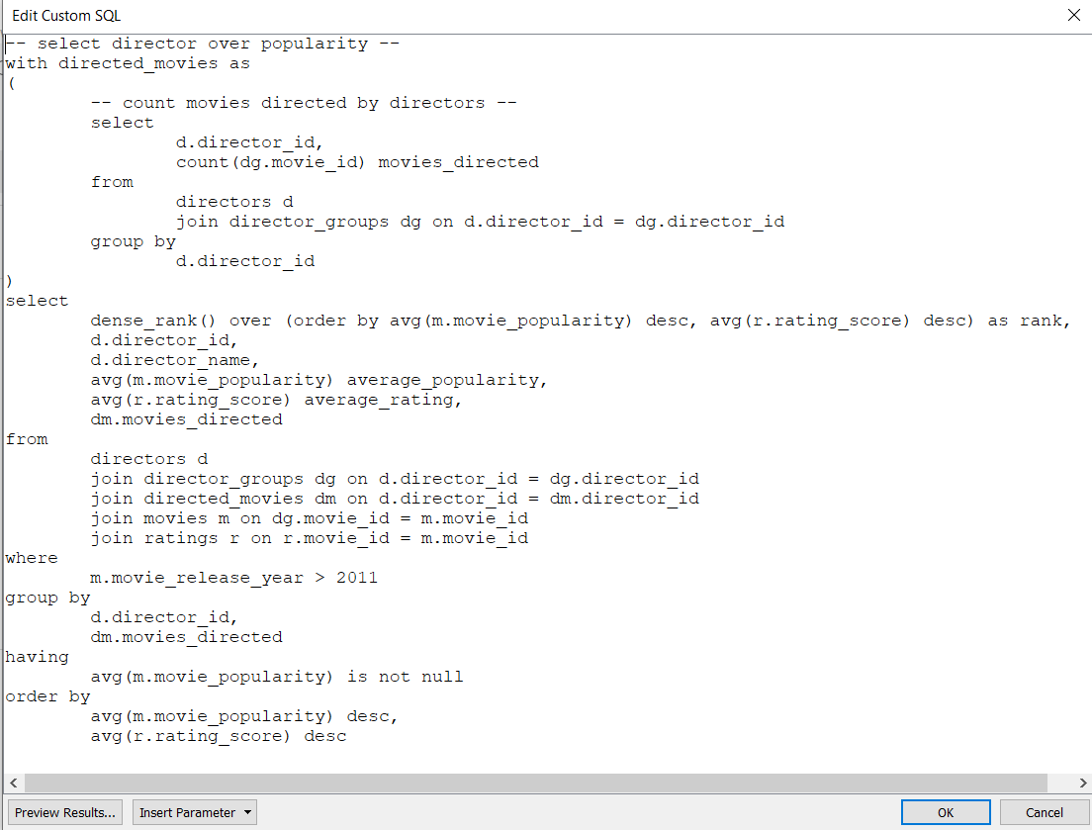
9
Rapoarte realizate în Tableau
1) Best movie directors over movies popularity in the last 10 years
Pentru acest raport, a fost utilizată funcționalitatea tool-ului de a genera tabele de date din comenzi SQL.
Notes:
Standard text slide (version 5)
Creating visual differences in text-heavy pages keeps the audience interested and engaged.
Using bold and highlighted coloured text draws the reader into the important part of the text. Use this sparing throughout the text, if it is used too much, the page becomes busy, it loses its’ meaning.
Varying the length of the paragraphs as well as using bulleted and numeric lists help with keeping the reader engaged. Lists help to “skim” the information on the page and allow the audience to absorb a just the key information.

Slide 25
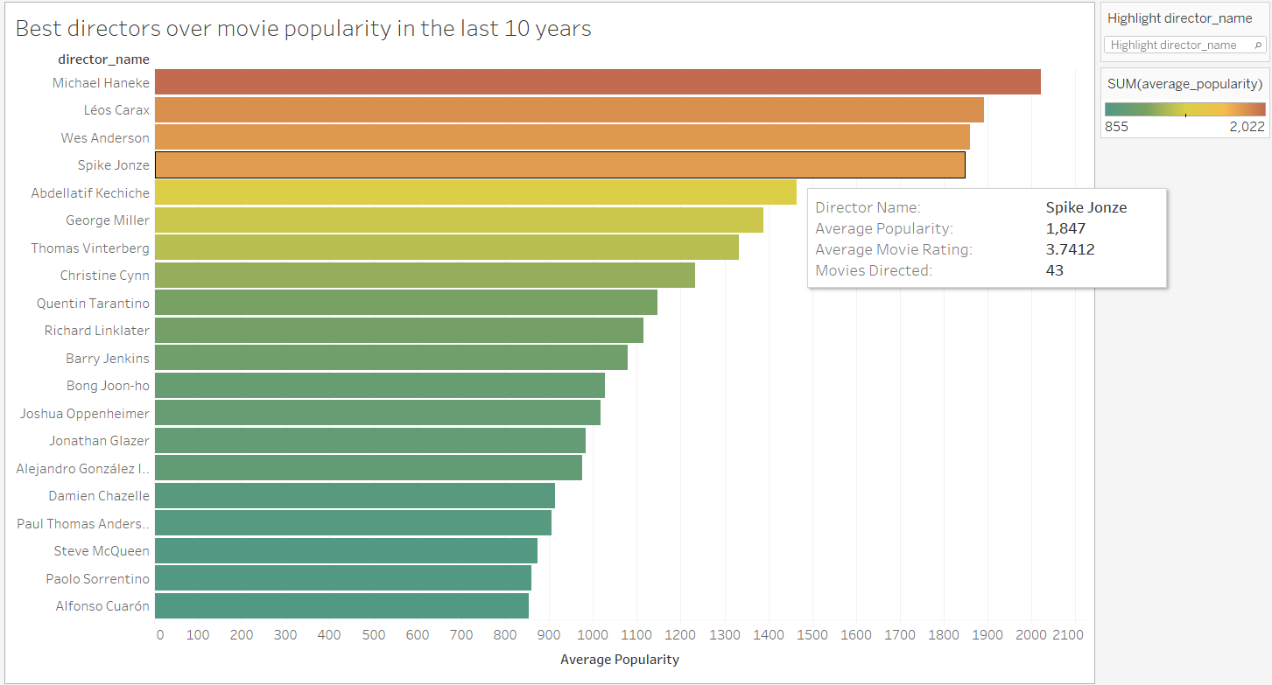
9
Rapoarte realizate în Tableau
1) Best movie directors over movies popularity in the last 10 years
Notes:
Standard text slide (version 5)
Creating visual differences in text-heavy pages keeps the audience interested and engaged.
Using bold and highlighted coloured text draws the reader into the important part of the text. Use this sparing throughout the text, if it is used too much, the page becomes busy, it loses its’ meaning.
Varying the length of the paragraphs as well as using bulleted and numeric lists help with keeping the reader engaged. Lists help to “skim” the information on the page and allow the audience to absorb a just the key information.

Slide 26
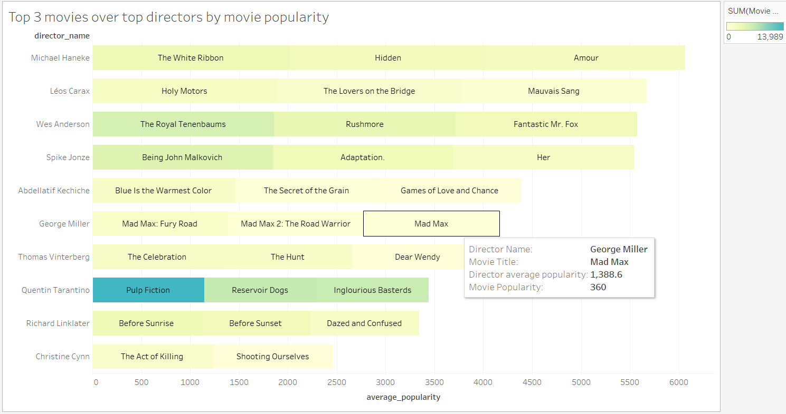
9
Rapoarte realizate în Tableau
2) Top 3 movies over popularity directed by this best directors
Notes:
Standard text slide (version 5)
Creating visual differences in text-heavy pages keeps the audience interested and engaged.
Using bold and highlighted coloured text draws the reader into the important part of the text. Use this sparing throughout the text, if it is used too much, the page becomes busy, it loses its’ meaning.
Varying the length of the paragraphs as well as using bulleted and numeric lists help with keeping the reader engaged. Lists help to “skim” the information on the page and allow the audience to absorb a just the key information.

Slide 27
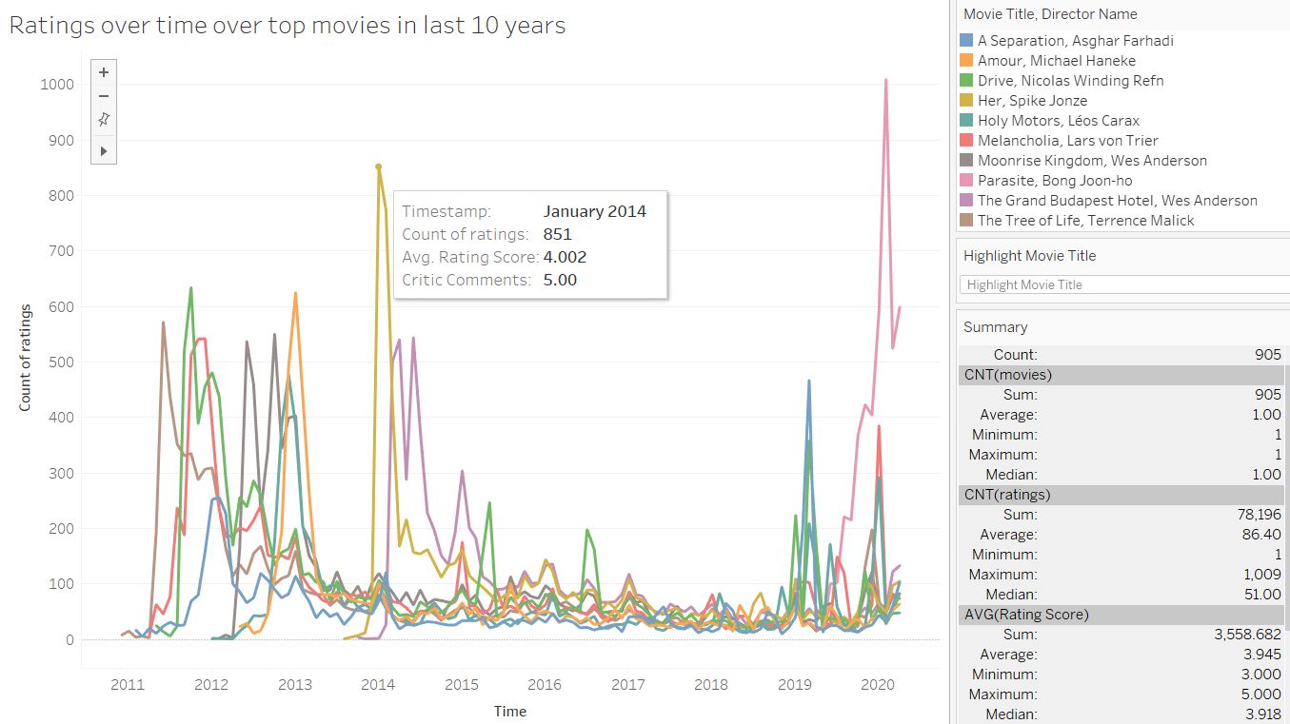
9
Rapoarte realizate în Tableau
3) Ratings over time over top movies in the last 10 years
Notes:
Standard text slide (version 5)
Creating visual differences in text-heavy pages keeps the audience interested and engaged.
Using bold and highlighted coloured text draws the reader into the important part of the text. Use this sparing throughout the text, if it is used too much, the page becomes busy, it loses its’ meaning.
Varying the length of the paragraphs as well as using bulleted and numeric lists help with keeping the reader engaged. Lists help to “skim” the information on the page and allow the audience to absorb a just the key information.

Slide 28
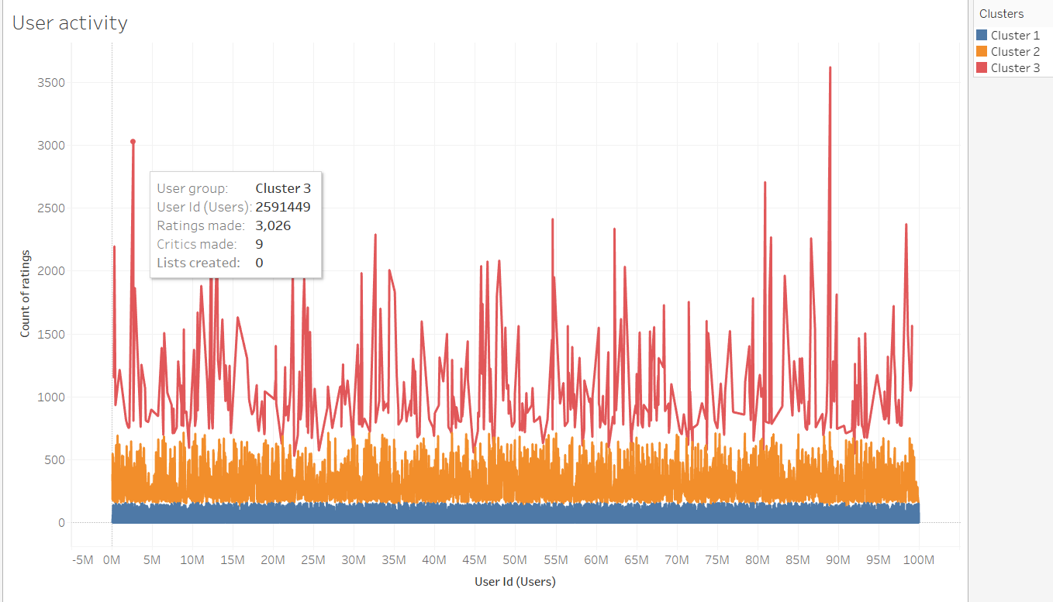
9
Rapoarte realizate în Tableau
4) User activity
Notes:
Standard text slide (version 5)
Creating visual differences in text-heavy pages keeps the audience interested and engaged.
Using bold and highlighted coloured text draws the reader into the important part of the text. Use this sparing throughout the text, if it is used too much, the page becomes busy, it loses its’ meaning.
Varying the length of the paragraphs as well as using bulleted and numeric lists help with keeping the reader engaged. Lists help to “skim” the information on the page and allow the audience to absorb a just the key information.

Slide 29
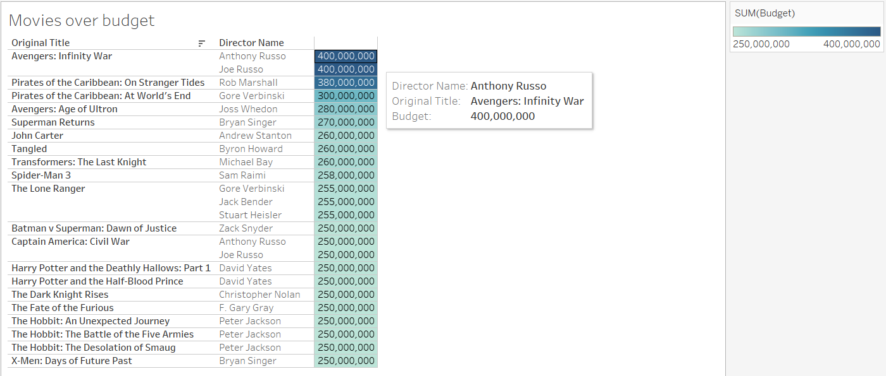
9
Rapoarte realizate în Tableau
5) Movies over budget
Notes:
Standard text slide (version 5)
Creating visual differences in text-heavy pages keeps the audience interested and engaged.
Using bold and highlighted coloured text draws the reader into the important part of the text. Use this sparing throughout the text, if it is used too much, the page becomes busy, it loses its’ meaning.
Varying the length of the paragraphs as well as using bulleted and numeric lists help with keeping the reader engaged. Lists help to “skim” the information on the page and allow the audience to absorb a just the key information.

Slide 30
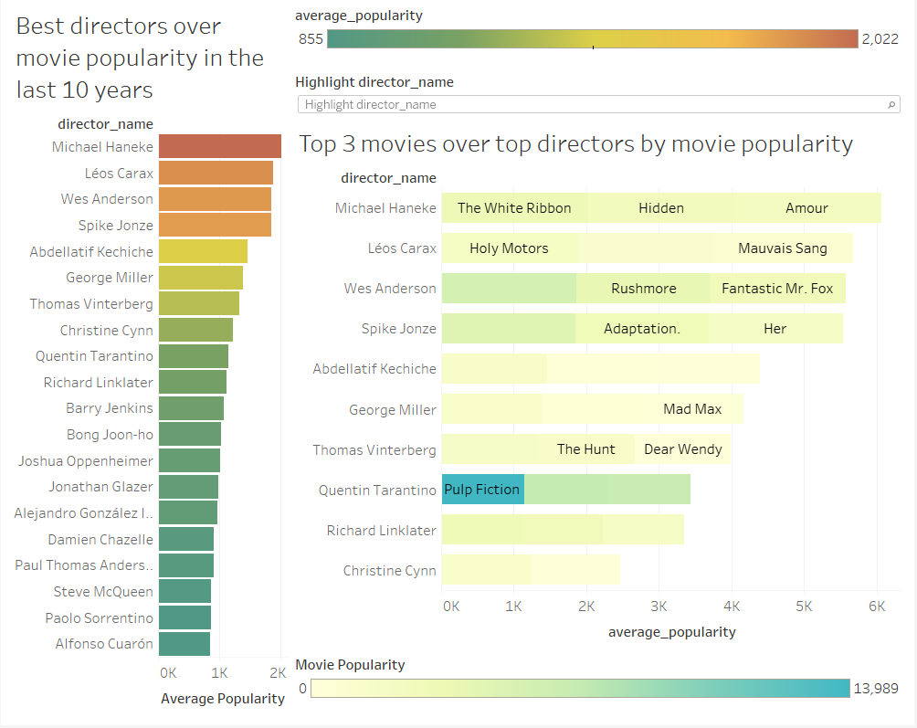
9
Rapoarte realizate în Tableau
6) Best Directors Dashboard
Notes:
Standard text slide (version 5)
Creating visual differences in text-heavy pages keeps the audience interested and engaged.
Using bold and highlighted coloured text draws the reader into the important part of the text. Use this sparing throughout the text, if it is used too much, the page becomes busy, it loses its’ meaning.
Varying the length of the paragraphs as well as using bulleted and numeric lists help with keeping the reader engaged. Lists help to “skim” the information on the page and allow the audience to absorb a just the key information.

Slide 31
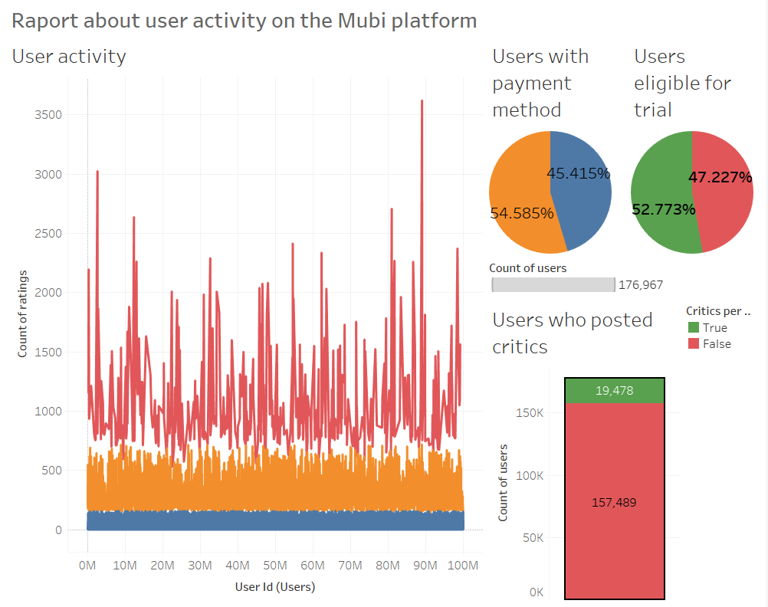
9
Rapoarte realizate în Tableau
7) User Activity Dashboard
Notes:
Standard text slide (version 5)
Creating visual differences in text-heavy pages keeps the audience interested and engaged.
Using bold and highlighted coloured text draws the reader into the important part of the text. Use this sparing throughout the text, if it is used too much, the page becomes busy, it loses its’ meaning.
Varying the length of the paragraphs as well as using bulleted and numeric lists help with keeping the reader engaged. Lists help to “skim” the information on the page and allow the audience to absorb a just the key information.

Slide 32
Useful links
https://www.kaggle.com/clementmsika/mubi-sqlite-database-for-movie-lovers
https://zenodo.org/record/1240586#.YSS1Xo4zZPZ
https://www.postgresql.org/docs/13/index.html
https://www.sqlite.org/docs.html
https://www.tableau.com/
https://help.talend.com/r/MW~bv2NtBd_sCQPsRNN2pA/lCqoKBO1L5I3HJrhQ49C8g
https://dbeaver.com/docs/wiki/
Notes:
Agenda
General Template Guidance: Information to help you make good presentations.
Standard / Static Slides: Some key Endava slides/lockups that, in general, should only be modified by marketing.
Template Slides: A selection of template slides for use in Endava presentations.
Larger Format Template Slides: Template slides with larger content.
Icon Library: A selection of hundreds of icons to use in Endava presentations.

